Slide 1
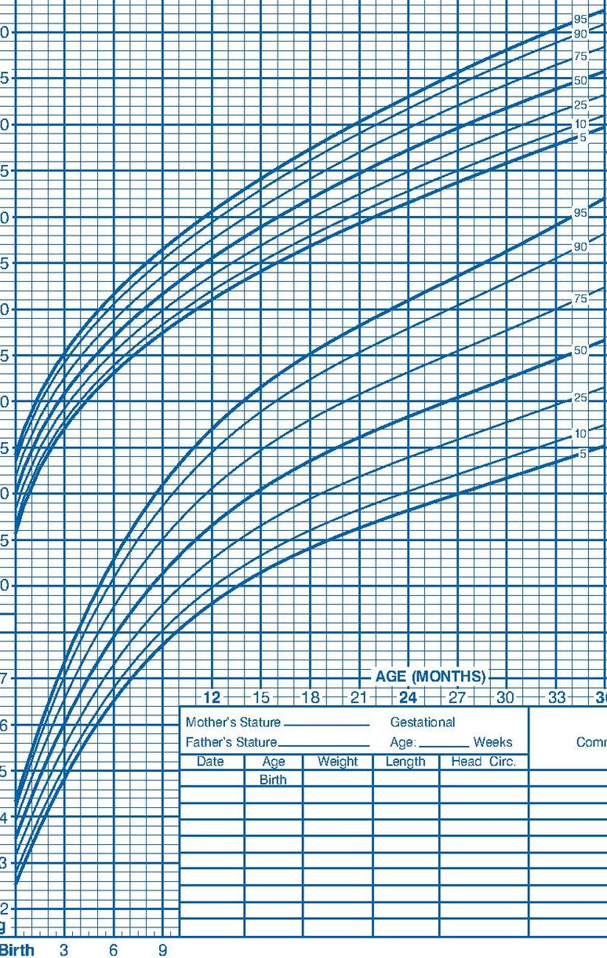
1. Ideas
2. Filter
Systolic (percentile)
Systolic (percentile)
Systolic (percentile)
Age
Systolic
Diastolic (percentile)
Diastolic (percentile)
Diastolic (percentile)
Blood pressure
Diastolic
Systolic
Systolic
Diastolic
Systolic (percentile)
Age
Age
Diastolic
Age
Age
Diastolic (percentile)
Blood pressure (percentile)
Blood pressure (percentile)
3. Categorize
2D scatter plot
Show patient’s data over time for comparison/trend
Age
Systolic (percentile)
Diastolic (percentile)
Systolic
Blood pressure
Diastolic
Age
5. Question
4. Combine and Refine
Answer blood pressure trends over time
Only for one specific patient
Switch axes (BP on y and age on x)
Brush selection of systolic and diastolic (take it easier to see them separately)
Include horizontal lines for cutoffs
95th, 99th %iles
95th %ile + 12 mmHg
Instead of blood pressure percentiles, display in terms of hypertension cutoffs to allow for continuity from pedi to adult cutoffs?
Systolic
Age
Diastolic
Blood pressure (percentile)
Also add growth chart-adaptation for familiarity of interpretation?

Slide 2
Layout
Title:
Author:
Date:
Sheet: 5
Task:
Operations
95th percentile + 12 mmHg
Systolic
Hover over data point: show text bubble with associated blood pressure reading and percentiles
Text box to the right of the plot shows pertinent diagnostic criteria and recommendations
95th percentile
Diastolic
90th percentile
hover
Blood pressure (mmHg)
70 / 46
92nd %ile / 60th %ile
Recommendations
Stage 1 hypertension diagnosis criteria: three measurements >95th percentile
Consider ABPM, diagnostic evaluation, subspecialty referral
50th percentile
Age (years)
Focus
Detail
Legend and plot are linked so that click on a series within the legend displays only those points in the graph; clicking elsewhere displays all data points
Clicking on a percentile line (i.e., 90th, 95th, 95th + 12) hides all points below that cutoff
Use published calculator to compute percentiles for each blood pressure data point
Give recommendations/diagnostic criteria based on American Academy of Pediatrics guidelines

Slide 3
Describe potential visualization challenges.
Overlapping data points may be an issues depending on how frequently patients have their vitals measured and documented (but this won’t be an issue with the NHANES data we’re using for proof of concept in this project).
There are different cutoffs/diagnostic criteria for people <13 years old and >= 13 years old, so we will need to design a way to transition smoothly between two different y axes.
Write two or three short paragraphs describing how you are planning to implement your application and how different components of your visualization will be interacting with each other. Note that your design may go beyond what you will actually be able to implement in your Streamlit app.
Ideally, this application would integrate into the EHR with FHIR, but we won’t be doing that in this project. Here, we will be implementing it as a standalone app that imports data from the NHANES data set with an option to also manually enter data.
The data will be used to calculate percentiles for the blood pressures (which are dependent on age, sex, and height) and plotted. The app will also match up the data points to the most appropriate diagnosis and diagnostic/treatment recommendations. This will then display in a text box to the right of the plot, so that the clinician user can act on the data.

